Slide 1
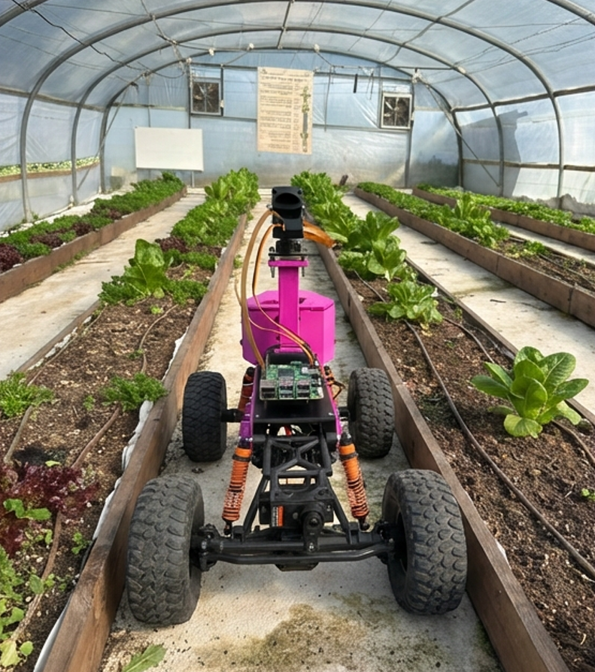

Robot Eco Farm
Autonomous greenhouse monitoring robot (Phase A)
Project code: 26-1-R-6
By: Israel Ohayun
Advisors : Dr. Naomi Unkelos‑Shpigel, Mr. Uzi Rosen
Link to GitHub:
https://github.com/xsrel77/Ronen-Autonomous-Vehicle-
Notes:
[Sources] - User report: Phase A - Robot Eco Farm (3).docx (figures + text) [/Sources]

Slide 2
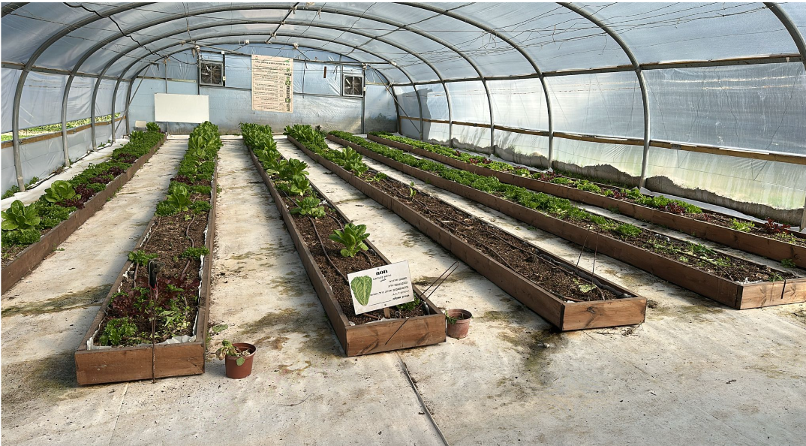
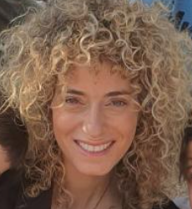
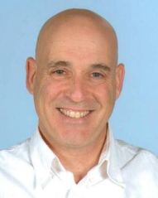
Stakeholders and Real-World Context
Greenhouse monitoring is hard
Keren Bensamhon Meshrki
Uzi Rosen
Farm Manager: Keren manages the farm in Karmiel where our project is planned to be deployed.
System Issues:Most of the time, there is no health check of the lettuce seedlings in the greenhouse.
Customer Requirement: A system that will independently test and present conclusions on a dedicated website.
Role: Uzi, a mechanical engineering lecturer, bridges between the software team and the mechanical team.
Key Support: He supervises students who work as required, both from software and from machines.
Knowledge support: Provides infrastructure for the MQTT server and information on working with sensors and mechanics.
Notes:
[Sources] - User report: Phase A - Robot Eco Farm (3).docx (figures + text) [/Sources]

Slide 3
The Problem: Limitations of Manual Greenhouse Monitoring
Greenhouse monitoring is hard
Manual checks are slow→ problems are found late
Weeds compete with the crop
Leaf disease can spread
Early rot reduces yield
Real greenhouse in Karmiel (community farm)
[1] Elstone., et al. (2020). High speed crop and weed identification in lettuce fields for precision weeding. Sensors
[2] Goyal., et al. (2025). Weed detection using deep learning in complex and highly occluded potato field environment.
[3] Abbasi., et al. (2023). Crop diagnostic system: A robust disease detection and smanagement system for leafy green crops.
[4] Mohanty, et al. (2016). Using deep learning for image-based plant disease detection. Frontiers in Plant Science
Notes:
[Sources] - User report: Phase A - Robot Eco Farm (3).docx (Introduction + Figure 1) [/Sources]

Slide 4
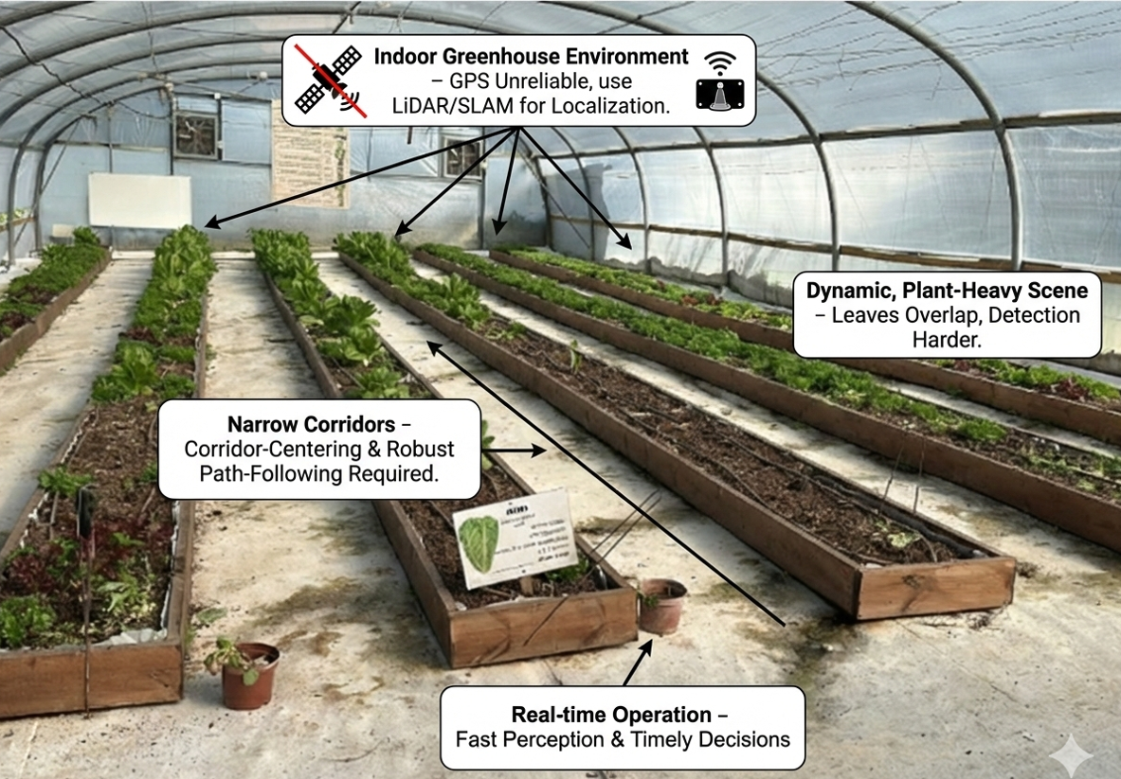
Constraints found in previous studies
Community Farm in Karmiel
Constraints
•6 long planters
•Changing light + occlusion
•Indoor greenhouse environment
•Narrow corridors between planter rows
•Dynamic, plant-heavy scene
•Real-time operation is important for field usability and timely decisions (fast perception loop).
[1] Macenski, S., & Jambrecic, I. (2021). SLAM Toolbox: SLAM for the dynamic world. JOSS.
[2] Li, Q., & Zhu, H. (2024). Performance Evaluation of LiDAR SLAM Algorithms in 2D Simulated Orchard Environments.
[3] Yoo, H., Baek, D., & Choi, S.-g. (2024). Path Navigation Following Platform for Greenhouse Shuttle Robot Using State Flow Method.
[4] Goyal, R., Nath, A., & Niranjan, U. (2025). Weed detection using deep learning in complex and highly occluded potato field environment.
[5] Elstone, L., et al. (2020). High Speed Crop and Weed Identification in Lettuce Fields for Precision Weeding. Sensors.
Notes:
[Sources] - User report: Phase A - Robot Eco Farm (3).docx (Section 2.1 + Figure 1) [/Sources]

Slide 5
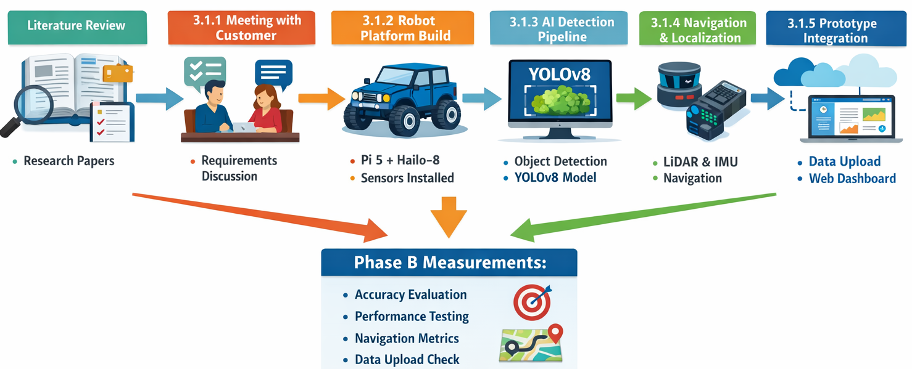
Project Goal
What we build
An autonomous 4×4 robot that:
Scans each greenhouse row
Detects weeds, disease, and rot
Uploads results to a web dashboard
End-to-end workflow: research → robot → web
Notes:
[Sources] - User report: Phase A - Robot Eco Farm (3).docx (Aim/Contribution + Figure 3) [/Sources]

Slide 6
System requirements
Area | FR (Atomic) | NFR
Field Operation | 1.Robot Scan corridors row-by-row. 2.Robot create greenhouse map during scanning. | Performance: Full scan cycle time ≤ 20 min Reliability: Map creation completes without crash for ≥ 95% of missions
Perception (Detection) | 3.Robot Detect: Person, Healthy Lettuce, Leaf Disease, Weed, Soil Rot. | Detection quality: mAP@0.5 ≥ 0.85 (Healthy), ≥ 0.80 (Leaf Disease), ≥ 0.80 (Weed) Runtime: Inference ≥ 20 FPS @ 640×640 (Pi 5 + Hailo-8)
Events | 4.Robot Log abnormal events when Weed or Leaf Disease is detected. | Confidence threshold: Abnormal-event logged only if confidence ≥ 0.70 (configurable) Reliability: No missing abnormal events in upload queue (buffering enabled)
Navigation & Localization | 5.Robot Center in corridor (LiDAR). 6.Robot stop on obstacle. | Accuracy: Lateral corridor error: mean ≤ 10 cm, max ≤ 20 cm Safety: Obstacle detection at ≥ 0.3 m, stop distance ≤ 0.1 m
Integration & UI | 7.Robot Upload abnormal events. 8.Robot store logs locally. 9.display events on web dashboard. 10.Robot support manual teleoperation. | Latency: Avg upload latency ≤ 5 s, 95% delivered ≤ 30 s (4G) Reliability: No data loss for disconnections up to 30 min (buffering)
Edge AI / Security | 11.Run inference on robot. 12.authenticate users for dashboard. | Access control: Dashboard access requires authenticated user (Firebase Auth)

Slide 7
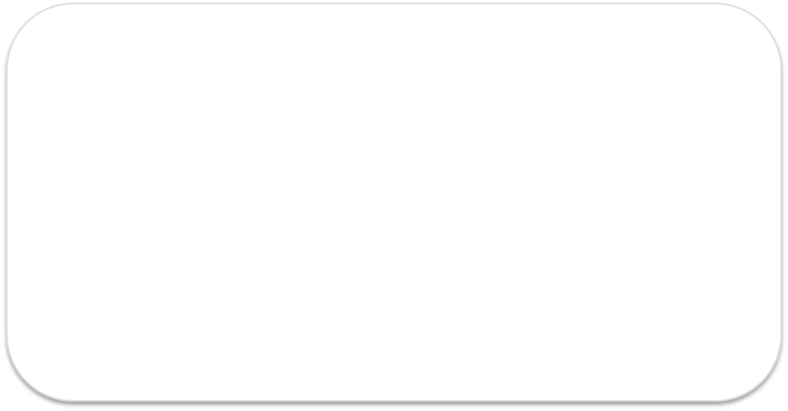
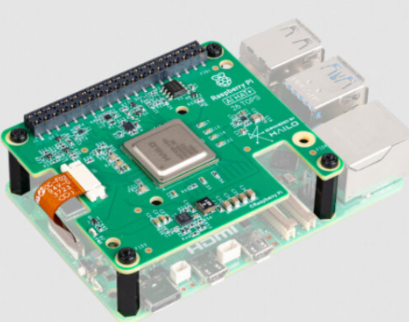
Edge AI
What it is & why it matters
What is Edge AI?
Why use it in our project?
•Edge AI = running AI inference on the device (the robot),
instead of sending images to a remote cloud server.
•Decisions happen locally (real-time).
•Only events/metadata need to be uploaded.
•Low latency for safety (stop / manual override).
•Works even with unstable 4G coverage.
•Lower bandwidth (no continuous video streaming).
•Better privacy (raw images stay on the robot).
•Higher reliability (robot keeps scanning offline).
Our implementation (Phase A → Phase B)
•Raspberry Pi 5 + Hailo-8 accelerator for on-device inference.
•Object detection model: YOLOv8s @ 640×640 (target ≥ 20 FPS).
•Upload abnormal events; buffer locally during disconnections.
Raspberry Pi 5 + Hailo‑8
Low power • fast inference on-device

Slide 8


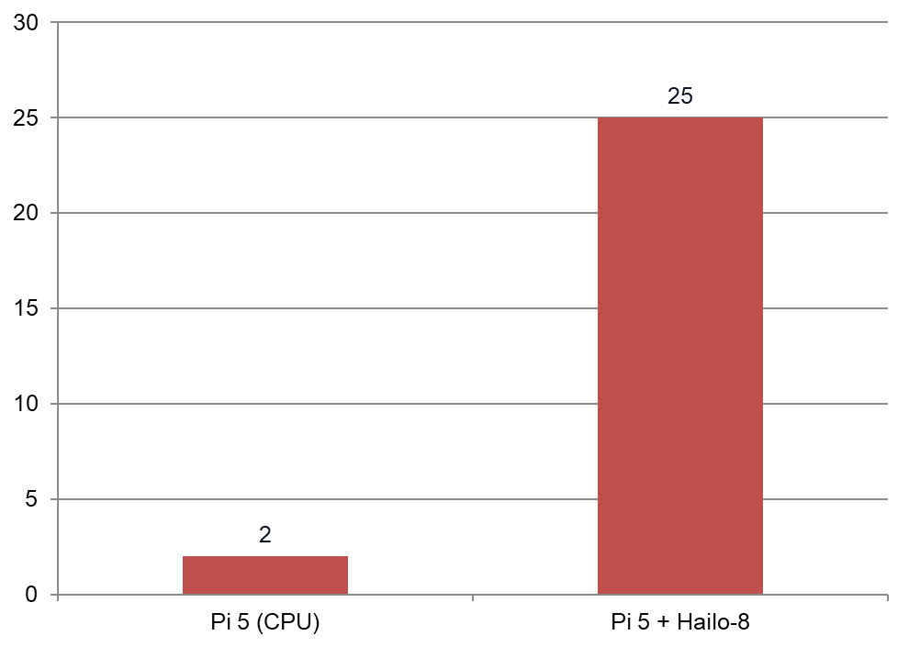
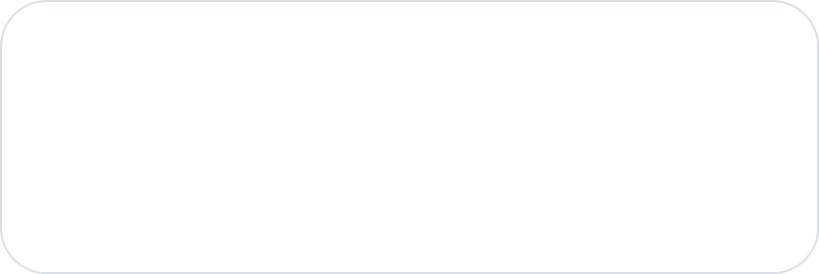
Pilot testing performance (Edge AI Hailo-8)
YOLOv8s
•Fast object detection (bounding boxes)
•Good quality–speed balance
•Runs on Raspberry Pi 5 + Hailo‑8
Training goal:
stable detection in a cluttered scene
Key takeaway
Hailo‑8 makes real‑time detection possible on a small robot.
•Target: ≥ 20 FPS
•Resolution: 640×640
•Output: box + class + confidence
Measured in the final pipeline (approx.)
Notes:
[Sources] - User report: Phase A - Robot Eco Farm (3).docx (Section 3.1.3: 1–3 FPS without accelerator; 20–30 FPS with Hailo‑8) [/Sources]

Slide 9
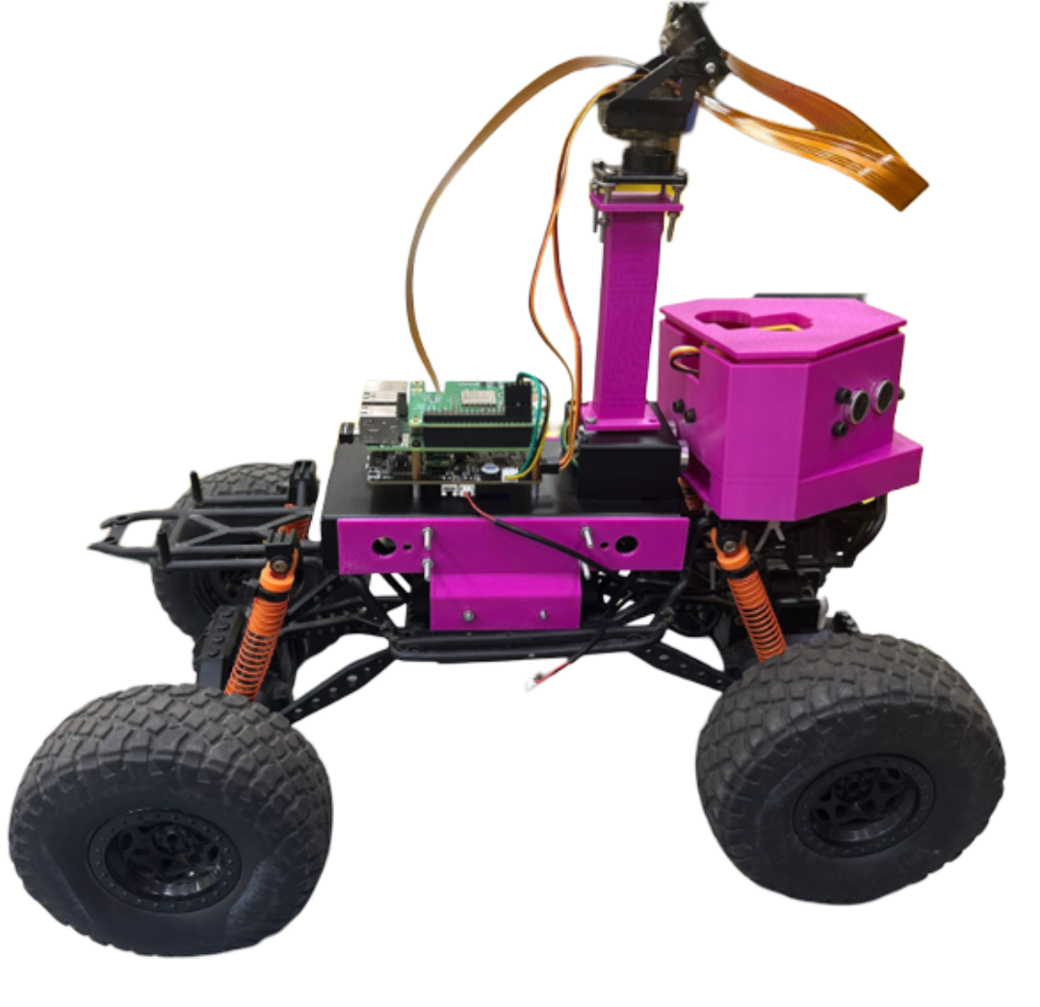
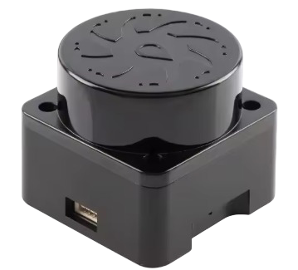
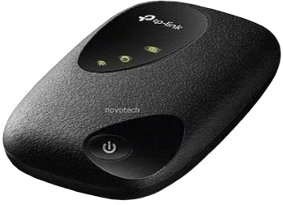
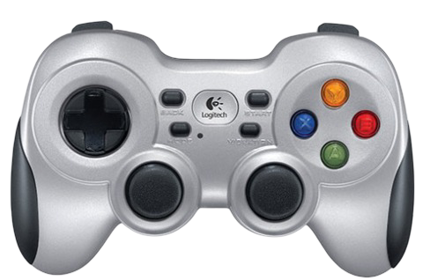
RoNen - Robot Platform
4×4 base + Raspbot V2 kit
M5stick controller
IMAX219 8 Megapixel Camera
IMU sensor
YDLIDAR T-mini Pro Plus
HAILO8 26TOPS
Temperature sensor
raspbeery pi5 8g ram
2 ultrasonic distance sensors
RaspbotV2 expansion board based on STC-8 processor
Machina Climbing Car Pro
Netstick - M7200 4G LTE Wi-Fi Cellular Modem
Logitech Wireless Gamepad F710 PC Wireless Controller
Built for narrow corridors • camera on pan–tilt • onboard sensors

Slide 10




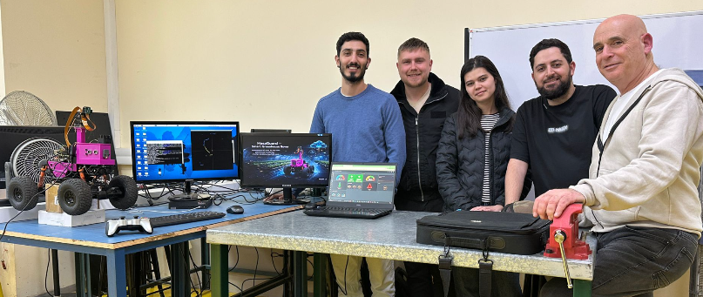
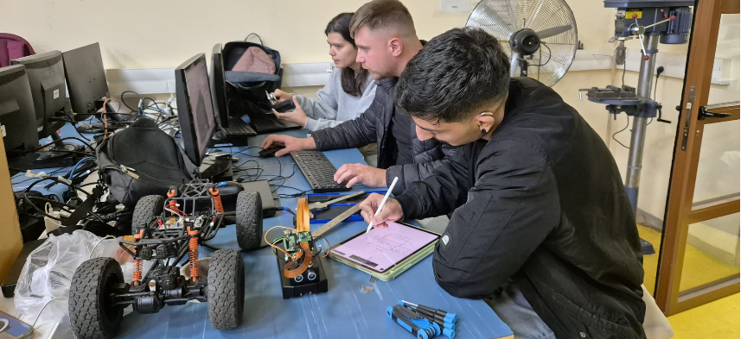
Mechanical Engineering Collaboration
Dashboard monitoring
3D-printed parts
IoT sensing add-on
Team contributions integrated into the greenhouse robot prototype
IMU sensor
Camera mast
M5stick controller
Led by Uzi Rosen
Team members: Shahar Avivi • Ella Smailov • Daniel Kislankov
Chassis brackets
Temperature sensor
Designed and 3D-printed the pink mechanical parts (mounts, brackets, enclosure)
Integrated an M5Stick sensor module as an IoT add-on (environment + motion + distance)
Improved stability, protection, and cable management for field operation
Enabled remote viewing of sensor telemetry through a Home Assistant dashboard (MQTT)
2 ultrasonic distance sensors
Sensor enclosure

Slide 11
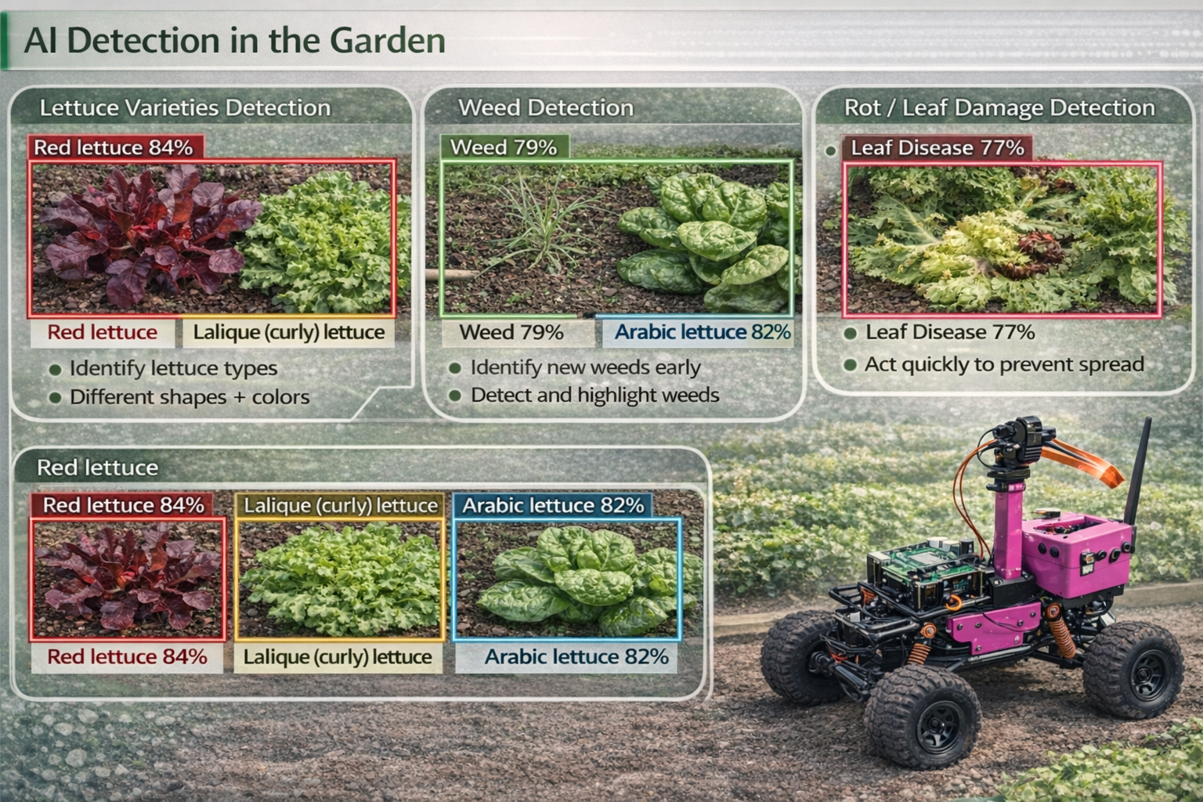
Detection Classes
Healthy Lettuce
Normal growth
Leaf Disease
Symptoms on leaves
Weed
Plants that compete with lettuce
Soil Rot
Rot near the base / soil
One model. Multiple targets. Simple output: box + class + confidence.
Notes:
[Sources] - User report: Phase A - Robot Eco Farm (3).docx (Section 2.2.1 + Figures 2) [/Sources]

Slide 12
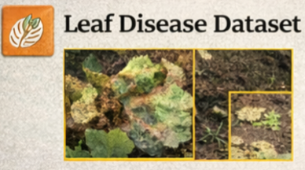
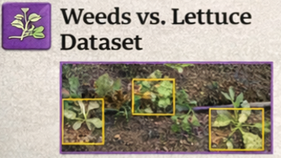
DataSets for Transfer Learning Yolov8s
Dataset | Type of Information | Number of Images | Contribution to the Project
Leaf Disease Dataset | Leaf damage, rot, wilting, discoloration (multiple disease types merged into one class: “Leaf Disease”) | ~650 images | Enables early detection of leaf diseases and rot, supports preventive actions, and reduces yield loss
Weeds vs. Lettuce Dataset | Weeds growing between lettuce plants (inter-row and near-plant weeds) | ~1060 images | Improves discrimination between crops and weeds in cluttered scenes, enabling accurate weed detection in narrow corridors
Notes:
[Sources] - User report: Phase A - Robot Eco Farm (3).docx (Section 3.1.3: YOLOv8s choice, datasets, 640×640) [/Sources]

Slide 13
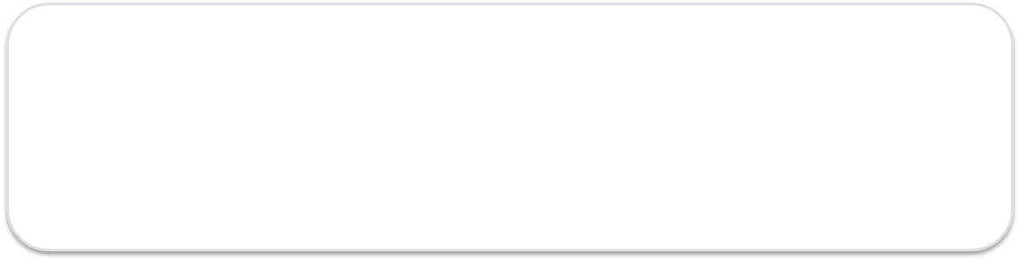



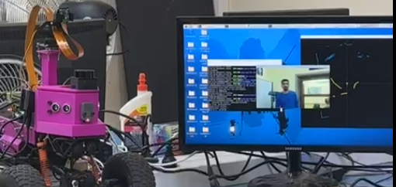
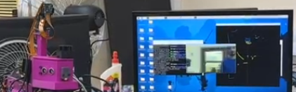
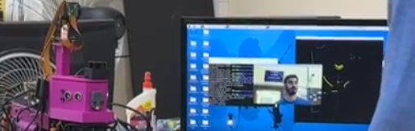
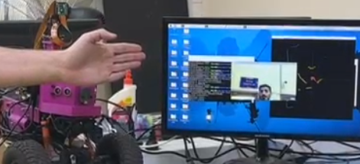
Software Progress (What I already built)
C++ • direct UART/I2C • Hailo acceleration
Far
Near
Collision
1) Mini LiDAR → Dynamic Map (SDL + C++)
•Built a live 2D map using SDL; LiDAR position is at the origin (0,0).
•Direct UART protocol (0xA5 + command) — no ready-made LiDAR libraries.
•Color coding by distance: blue = far, yellow = near, red = imminent collision.
2) RaspbotV2 Board → Direct Registers (C++)
•Implemented direct register I2C control (vendor guide) — no high-level wrappers.
•Wheel driving tested up to 20 km/h.
•SERVO motion implemented for aiming/target alignment.
3) YOLOv8s Person Detection + Hailo LOGs
•Real-time Person detection using YOLOv8s on Hailo-8.
•Saved runtime LOG files during inference using Hailo libraries (HailoRT / TAPPAS logging).
Notes:
[Sources] - User report: Phase A - Robot Eco Farm (3).docx (Section 3.1.4: LiDAR+IMU navigation + targets) [/Sources]

Slide 14
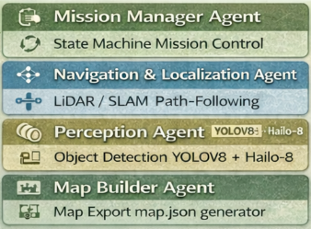
Next Step: ROS 2 Humble Microservices
From C++ modules → ROS 2 nodes (agents)
Current software modules (C++)
Planned ROS 2 Humble microservices
Each capability becomes an independent ROS 2 node (agent):
•mission_manager_node (state machine / actions)
•nav_localization_node (LiDAR/SLAM, corridor centering)
•perception_node (YOLOv8s + Hailo-8 inference)
•map_builder_node (map.json export + SDL debug view)
•hw_interface_node (RaspbotV2 registers: motors/servo/sensors)
•mqtt_bridge_node (robot ↔ web: publish/subscribe)
Interfaces:
•Topics: scans, pose, detections, status
•Services/Actions: start_mission, stop_mission, set_params
•Already implemented in C++ (Phase A):
•LiDAR mapping (SDL) + raw UART protocol parsing
•Direct board control (I2C registers): driving + servo aiming
•YOLOv8s Person detection on Hailo + runtime logs
Why ROS 2 Humble: modular testing, independent deployment, and clean interfaces between navigation, perception, mapping, and web integration.
Notes:
[Sources] - User report: Phase A - Robot Eco Farm (3).docx (Section 3.1.4: LiDAR+IMU navigation + targets) [/Sources]

Slide 15
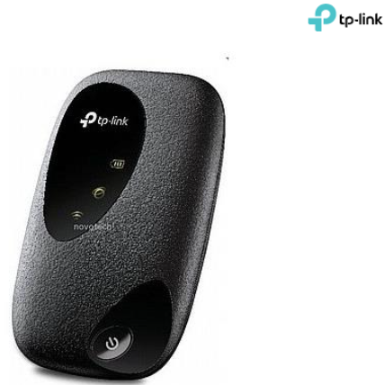
Robot ↔ Web Dashboard
Operational workflow
Robot
4G Modem
Server
Detect + log
Internet link
Store events
Message:
The farm manager gets remote updates in near real-time.
Upload abnormal events (weed / disease)
Buffer locally if the network drops
Show row status + history
Notes:
[Sources] - User report: Phase A - Robot Eco Farm (3).docx (Section 3.1.5: robot ↔ server/website integration, 4G modem) [/Sources]

Slide 16
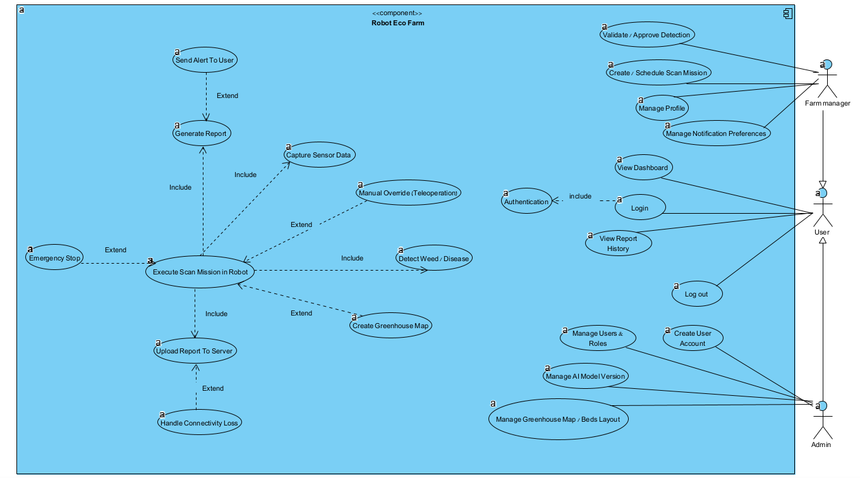
USE CASE of the entire system Website + Robot
ROS 2 nodes (agents)
Notes:
[Sources] - User report: Phase A - Robot Eco Farm (3).docx (Section 3.3.1 ROS 2 + planned nodes; use case figure) [/Sources]

Slide 17

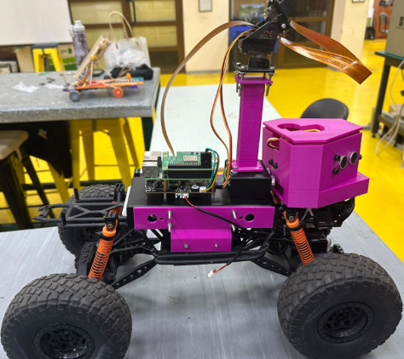








Software Architecture
Client side
ROS 2 Humble microservices
Server side
Cloud MQTT
(Backend)
Sensors
REST API
Frontend Stack
REST API
Backend Stack
JavaScript
Database
ReactJS
NodeJS
JavaScript
Notes:
[Sources] - User report: Phase A - Robot Eco Farm (3).docx (Section 3.1.4: LiDAR+IMU navigation + targets) [/Sources]

Slide 18
Key Requirements & Metrics
How we measure success
Performance & AI
Safety & Navigation
Scan cycle ≤ 20 min
Inference ≥ 20 FPS @ 640×640 (Pi 5 + Hailo-8)
Healthy Lettuce mAP@0.5 ≥ 0.85
Leaf Disease mAP@0.5 ≥ 0.80
Weed mAP@0.5 ≥ 0.80
Lateral error: mean ≤ 10 cm, max ≤ 20 cm
Obstacle detect ≥ 0.3 m; stop distance ≤ 0.1 m
Abnormal-event threshold ≥ 0.70 (configurable)
Cloud / Data / Security
Upload latency: avg ≤ 5 s; 95% ≤ 30 s (4G)
No data loss up to 30 min disconnection (buffering)
Dashboard access: authenticated user (Firebase Auth)
Notes:
[Sources] - User report: Phase A - Robot Eco Farm (3).docx (Section 3.2 requirements table + metrics targets) [/Sources]

Slide 19
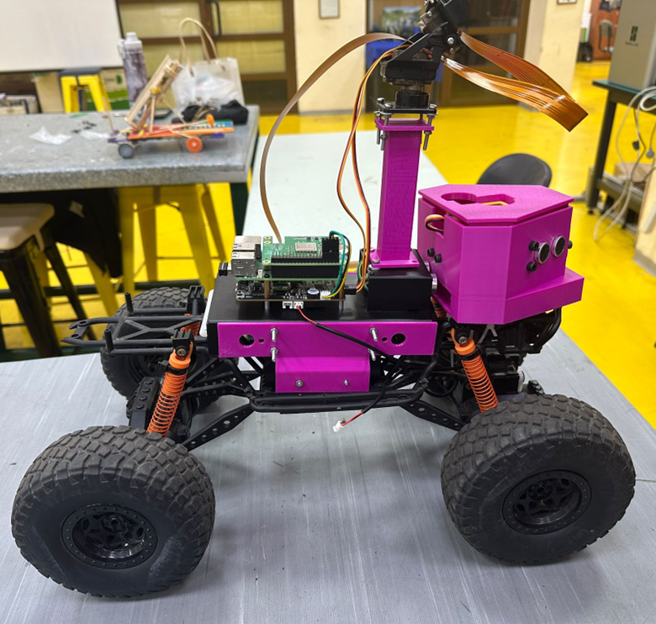
Phase A Progress
What is already done
Delivered in Phase A
Built 4×4 robot platform
Integrated camera + LiDAR + IMU
YOLO detection pipeline on Pi + Hailo
m5stick connected with sensors
Next: validate metrics
in real greenhouse runs
Notes:
[Sources] - User report: Phase A - Robot Eco Farm (3).docx (Section 3.1 progress subsections) [/Sources]

Slide 20
Phase B (Next)
Plan + Questions
Phase B focus
Questions?
Run full scans in the greenhouse
Measure mAP / precision / recall
Measure navigation accuracy
Creating dataset for hard lighting cases
Finalize web dashboard for daily use
Thank you
Israel Ohayun
Notes:
[Sources] - User report: Phase A - Robot Eco Farm (3).docx (Phase B targets + tests/metrics section) [/Sources]

